Slide 1
WPF and MVVM
Parameswari.E

Slide 2
What is WPF
WPF is modern graphical display system for windows.
It’s radical change from previous technologies that came before it with innovative features such as Hardware acceleration and resolution independence.
WPF is the best toolkit to build rich desktop applications that can run on windows platform.

Slide 3
The Evolution of Windows Graphics
A standard Windows application relies on two well-worn parts of the Windows operating system to create its user interface:
User32. This provides the familiar Windows look and feel for elements such as
windows, buttons, text boxes, and so on.
GDI/GDI+. This provides drawing support for rendering shapes, text, and images
at the cost of additional complexity (and often lackluster performance).
Over the years, both technologies have been refined, and the APIs that developers use to interact with them have changed dramatically

Slide 4
DirectX: The New Graphics Engine
Microsoft created one way around the limitations of the User32 and GDI/GDI+ libraries: DirectX.
DirectX began as a cobbled-together, error-prone toolkit for creating games on the Windows platform.
Its design mandate was speed, and so Microsoft worked closely with video card vendors to give DirectX the hardware acceleration needed for complex textures, special effects such as partial transparency, and three-dimensional graphics.
Over the years since it was first introduced (shortly after Windows 95), DirectX has matured.
It’s now an integral part of Windows, with support for all modern video cards. However, the programming API for DirectX still reflects its roots as a game developer’s toolkit.
Because of its raw complexity, DirectX is almost never used in traditional types of Windows applications (such as business software).

Slide 5
WPF
In WPF, the underlying graphics technology isn’t GDI/GDI+. Instead, it’s DirectX.
Remarkably, WPF applications use DirectX no matter what type of user interface you create.
That means that whether you’re designing complex three-dimensional graphics (DirectX’s forte) or just drawing buttons and plain text, all the drawing work travels through the DirectX pipeline.
As a result, even the most mundane business applications can use rich effects such as transparency and anti-aliasing.

Slide 6
Hardware Acceleration and WPF
if you run a WPF application on a computer with a legacy video card, the interface will still appear the way you designed it.
For hardware rendering, few things that have most of the impact are:
Video RAM: This determines the size and number of buffers that the application might use to render its output.
Pixel Shader: It is a graphics utility which calculates effects on per pixel basis.
Vertex Shader: It is a graphics processing utility that performs mathematical calculations on Vertex of the output. They are used to add special effects to objects in 3D environment.
MultiTexture Blending: This is a special function that allows you to apply two or more textures on the same object in 3D.

Slide 7
Hardware Acceleration and WPF
if you run a WPF application on a computer with a legacy video card, the interface will still appear the way you designed it.
WPF recognizes three rendering tiers:
Rendering Tier 0. The video card will not provide any hardware acceleration. This corresponds to a DirectX version level of less than 7.0.
Rendering Tier 1. The video card can provide partial hardware acceleration. This corresponds to a DirectX version level greater than 7.0 but less than 9.0.
Rendering Tier 2. All features that can be hardware accelerated will be. This corresponds to a DirectX version level greater than or equal to 9.0.

Slide 8
WPF: A Higher-Level API
WPF offered was hardware acceleration through DirectX, it would be a compelling
improvement but not a revolutionary one.
But WPF actually includes a basket of high-level services designed for application programmers.
A web-like layout model.
A rich drawing model
A rich text model
Animation as a first-class programming concept
Support for audio and video media

Slide 9
WPF: A Higher-Level API
Styles and templates
Commands.
Declarative user interface.
Page-based applications

Slide 10
Resolution independece
Traditional Windows applications are bound by certain assumptions about resolution.
Developers usually assume a standard monitor resolution (such as 1024 by 768 pixels), design their windows with that in mind, and try to ensure reasonable resizing behavior for smaller and larger dimensions.
The problem is that the user interface in traditional Windows applications isn’t scalable.
As a result, if you use a high monitor resolution that crams pixels in more densely, your application windows become smaller and more difficult to read.
This is particularly a problem with newer monitors that have high pixel densities and run at correspondingly high resolutions.

Slide 11
Resolution independece
WPF doesn’t suffer from this problem because it renders all user interface elements itself, from simple shapes to common controls such as buttons.
As a result, if you create a button that’s 1 inch wide on your computer monitor, it can remain 1 inch wide on a high-resolution monitor—WPF will simply render it in greater detail and with more pixels.

Slide 12
WPF Units
A WPF window and all the elements inside it are measured using device-independent units.
A single device-independent unit is defined as 1/96 of an inch.
Imagine that you create a small button in WPF that’s 96 by 96 units in size.
If you’re using the standard Windows DPI setting (96 dpi), each device-independent unit corresponds to one real, physical pixel.
That’s because WPF uses this calculation:
[Physical Unit Size] = [Device-Independent Unit Size] × [System DPI]
= 1/96 inch × 96 dpi
= 1 pixel

Slide 13
WPF Units
For example, consider a 19-inch LCD monitor with a maximum resolution of 1600 by 1200 pixels.
Using a dash of Pythagoras, you can calculate the pixel density for this monitor, as shown here:

Slide 14
Bitmap and Vector Graphics
When you work with ordinary controls, you can take WPF’s resolution independence for granted.
WPF takes care of making sure that everything has the right size automatically.
when designing a WPF user interface, even the smallest icon is generally implemented as a vector graphic.
Vector graphics are defined as a set of shapes, and as such they can be easily scaled to any size.

Slide 15
The Architecture of WPF

Slide 16
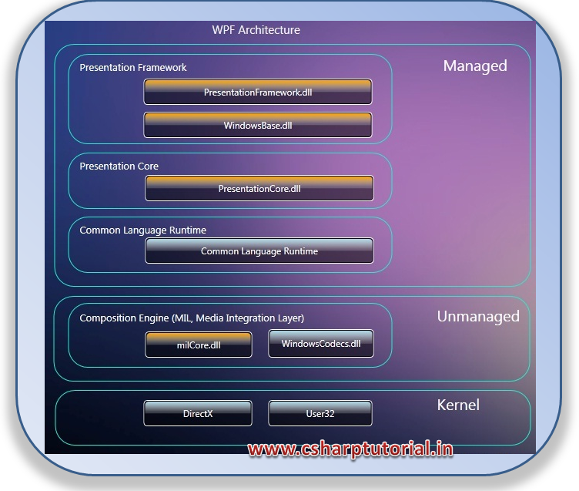
The Architecture of WPF

Slide 17
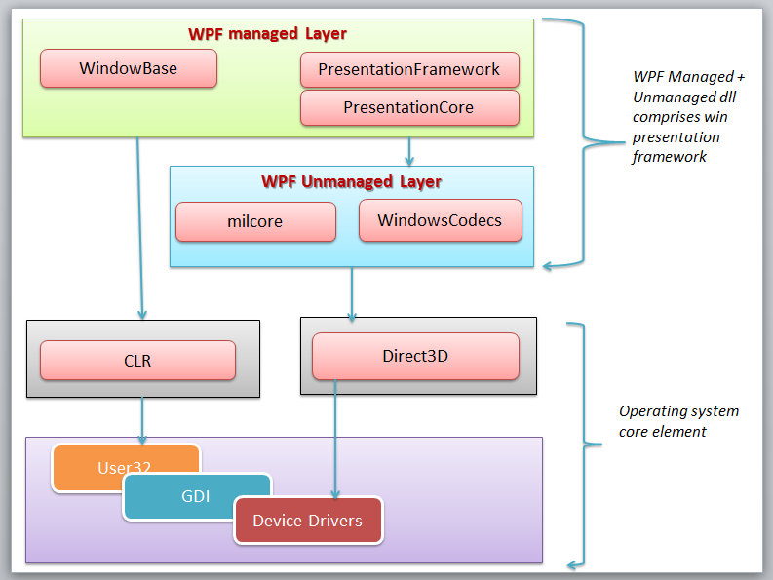
The Architecture of WPF

Slide 18
The Architecture of WPF
PresentationFramework.dll.
This holds the top-level WPF types, including those that represent windows, panels, and other types of controls.
It also implements higher-level programming abstractions such as styles.
Most of the classes you’ll use directly come from this assembly.

Slide 19
The Architecture of WPF
PresentationCore.dll.
This holds base types, such as UIElement and Visual, from which all shapes and controls derive.
If you don’t need the full window and control abstraction layer, you can drop down to this level and still take advantage of WPF’s rendering engine.

Slide 20
The Architecture of WPF
WindowsBase.dll.
This holds even more basic ingredients that have the potential to be reused outside of WPF, such as DispatcherObject and DependencyObject, which introduces the plumbing for dependency properties

Slide 21
The Architecture of WPF
milcore.dll.
This is the core of the WPF rendering system and the foundation of the Media Integration Layer (MIL).
Its composition engine translates visual elements into the triangle and textures that Direct3D expects.
Although milcore.dll is considered part of WPF, it’s also an essential system component for Windows Vista and Windows 7.
In fact, the Desktop Window Manager (DWM) uses milcore.dll to render the desktop.
milcore.dll is sometimes referred to as the engine for “managed graphics.”
Much as the common language runtime (CLR) manages the lifetime of a .NET application, milcore.dll manages the display state.

Slide 22
The Architecture of WPF
WindowsCodecs.dll. This is a low-level API that provides imaging support (for
example, processing, displaying, and scaling bitmaps and JPEGs).
Direct3D. This is the low-level API through which all the graphics in a WPF
application are rendered.
User32. This is used to determine what program gets what real estate. As a result,
it’s still involved in WPF, but it plays no part in rendering common controls.

Slide 23
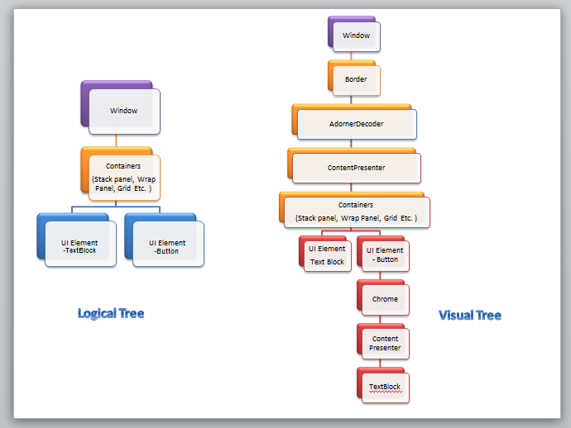
Visual tree or logical tree

Slide 24
The Class Hierarchy

Slide 25
The Class Hierarchy
System.Threading.DispatcherObject
WPF applications use the familiar single-thread affinity (STA) model, which means the entire user interface is owned by a single thread.
It’s not safe to interact with user interface elements from another thread.
To facilitate this model, each WPF application is governed by a dispatcher that coordinates messages

Slide 26
The Class Hierarchy
System.Windows.DependencyObject
In WPF, the central way of interacting with onscreen elements is through properties.
Early on in the design cycle, the WPF architects decided to create a more powerful property model that baked in features such as change notification, inherited default values, and more economical property storage.
By deriving from DependencyObject, WPF classes get support for dependency properties.

Slide 27
The Class Hierarchy
Every WPF control is derived from DependencyObject. DependencyObject is a class that supports DependencyProperty, a property system that is newly built in WPF.
Every object is derived from DependencyObject and hence it can associate itself in various inbuilt features of WPF like EventTriggers, PropertyBindings, Animations, etc.
Every DependencyObject actually has an Observer or a List and declares 3 methods called ClearValue, SetValue and GetValue which are used to add/edit/remove those properties.
Thus the DependencyProperty will only create itself when you use SetValue to store something. Thus, it is resource saving as well.

Slide 28
The Class Hierarchy
System.Windows.Media.Visual
Every element that appears in a WPF window is, at heart, a Visual.
Visual class as a single drawing object that encapsulates drawing instructions, additional details about how the drawing should be performed (such as clipping, opacity, and transformation settings), and basic functionality (such as hit testing).
The Visual class also provides the link between the managed WPF libraries and the milcore.dll that renders your display.
Any class that derives from Visual has the ability to be displayed on a window.

Slide 29
The Class Hierarchy
System.Windows.UIElement
UIElement adds support for WPF essentials such as layout, input, focus, and events (which the WPF team refers to by the acronym LIFE). For example, it’s here that the two-step measure and arrange layout process is defined.
It’s also here that raw mouse clicks and key presses are transformed to more useful events such as MouseEnter.
As with properties, WPF implements an enhanced event-passing system called routed events.
Finally, UIElement adds supports for commands

Slide 30
The Class Hierarchy
System.Windows.FrameworkElement
Framework Element is the final stop in the core WPF inheritance tree.
It implements some of the members that are merely defined by UIElement.
For example, UI Element sets the foundation for the WPF layout system, but Framework Element includes the key properties (such as Horizontal Alignment and Margin) that support it.
UI Element also adds support for data binding, animation, and styles, all of which are core features.

Slide 31
The Class Hierarchy
System.Windows.Shapes.Shape
Basic shapes classes, such as Rectangle, Polygon, Ellipse, Line, and Path, derive from this class.
These shapes can be used alongside more traditional Windows widgets such as buttons and text boxes.

Slide 32
The Class Hierarchy
System.Windows.Controls.Control
A control is an element that can interact with the user.
It obviously includes classes such as TextBox, Button, and ListBox.
The Control class adds additional properties for setting the font and the foreground
and background colors.
But the most interesting detail it provides is template support, which allows you to replace the standard appearance of a control with your own stylish drawing.

Slide 33
The Class Hierarchy
System.Windows.Controls.ContentControl
This is the base class for all controls that have a single piece of content. This includes everything from the humble Label to the Window.
Single piece of content can be anything from an ordinary string to a layout panel with a combination of other shapes and controls.

Slide 34
The Class Hierarchy
System.Windows.Controls.ItemsControl
This is the base class for all controls that show a collection of items, such as the ListBox and TreeView.
List controls are remarkably flexible—for example, using the features that are built into the ItemsControl class, you can transform the lowly ListBox into a list of radio buttons, a list of check boxes, a tiled display of images, or a combination of completely different elements that you’ve chosen.
In fact, in WPF, menus, toolbars, and status bars are actually specialized lists, and the classes that implement them all derive from ItemsControl.

Slide 35
The Class Hierarchy
System.Windows.Controls.Panel
This is the base class for all layout containers—elements that can contain one or more children and arrange them according to specific layout rules.
These containers are the foundation of the WPF layout system, and using them is the key to arranging your content in the most attractive, flexible way possible.

Slide 36
Version changes
WPF Version | Release (YYYY-MM) | .NET Version | Visual Studio Version | Major Features
3.0 | 2006-11 | 3.0 | N/A | Initial Release. WPF development can be done with VS 2005 (released in Nov 2005) too with few additions as described here.
3.5 | 2007-11 | 3.5 | VS 2008 | Changes and improvements in: Application model, data binding, controls, documents, annotations, and 3-D UI elements.
3.5 SP1 | 2008-08 | 3.5 SP1 | N/A | Native splash screen support, New WebBrowser control, DirectX pixel shader support. Faster startup time and improved performance for Bitmap effects.
4.0 | 2010-04 | 4.0 | VS 2010 | New controls: Calendar, DataGrid, and DatePicker. Multi-Touch and Manipulation
4.5 | 2012-08 | 4.5 | VS 2012 | New Ribbon control New INotifyDataErrorInfo interface
4.5.1 | 2013-10 | 4.5.1 | VS 2013 | No Major Change
4.5.2 | 2014-05 | 4.5.2 | N/A | No Major Change
4.6 | 2015-07 | 4.6 | VS 2015 | Transparent child window support HDPI and Touch improvements

Slide 37
Version changes
WPF 3.0. The first version of WPF was released with two other new technologies:
Windows Communication Foundation (WCF) and Windows Workflow Foundation
(WF). Together, these three technologies were called the .NET Framework 3.0.
WPF 3.5. A year later, a new version of WPF was released as part of the .NET
Framework 3.5. The new features in WPF are mostly minor refinements, including
bug fixes and performance improvements.

Slide 38
Version changes
WPF 3.5 SP1. When the .NET Framework Service Pack 1 (SP1) was released, the
designers of WPF had a chance to slip in a few new features, such as slick graphical
effects (courtesy of pixel shaders) and the sophisticated DataGrid control.
WPF 4. WPF adds a number of refinements, including some valuable new features that build on the existing WPF infrastructure.
Some of the most notable changes include better text rendering, more natural animation,
and support for Windows 7 features such as multitouch and the new taskbar.

Slide 39
Version changes
WPF 4.6.
WPF 4.5 has very few changes.
It reflects status and technology maturity.
Ribbon control
Improved performance when displaying large sets of grouped data
New features for the VirtualizingPanel
Binding to static properties

Slide 40
Version changes
Accessing collections on non-UI Threads
Synchronously and Asynchronously validating data
Automatically updating the source of a data binding
Binding to types that Implement ICustomTypeProvider
Retrieving data binding information from a binding expression
Checking for a valid DataContext object
Repositioning data as the data's values change (Live shaping)
Improved Support for Establishing a Weak Reference to an Event
New methods for the Dispatcher class
Markup Extensions for Events

Slide 41
Version changes
WPF 4.6 Enhancements
HDPI improvements: HDPI support in WPF is now better in the .NET Framework 4.6. Changes have been made to layout rounding to reduce instances of clipping in controls with borders.
Transparent child window support: WPF in the .NET Framework 4.6 supports transparent child windows in Windows 8.1 and above. This allows you to create non-rectangular and transparent child windows in your top-level windows. You can enable this feature by setting the HwndSourceParameters.UsesPerPixelTransparency property to true.
Touch Improvements: In older version, touch produces unpredictable behavior have been addressed in the .NET Framework 4.6. The double tap threshold for Windows Store applications and WPF applications is now the same in Windows 8.1 and above.

Slide 42
Types of WPF Application (Windows Based and Browser Based)
Traditional Desktop Applications
Navigation Based WPF Application
WPF Browser Hosted Applications (XBAP)

Slide 43
Traditional Desktop Application
Executable Assembly that runs on a local machine.
Like any other desktop applications, these applications can be installed through setups , Windows Installer Packages or via Click Once technology to allow desktop applications to be distributed and installed via a remote web server.

Slide 44
Navigation based WPF apllication
WPF applications can optionally choose to make use of a navigation-based structure, which makes a traditional desktop application take on the basic behavior of a web browser application.
Provides a “forward” and “back” button.
The application itself maintains a list of each page and provides the necessary infrastructure to navigate between them, pass data across pages (similar to a web-based application variable), and maintain a history list.

Slide 45
XBAP Applications
Build applications hosted in a webbrowser
End User navigates to a url where XBAP(Collection of Pages) is transparently downloaded and installed to a local machine.
These are compiled to .xbap files
These applications run within a security sandbox to prevent untrusted applications from controlling local system resources.

Slide 46
Types of WPF Application
 | WPF Desktop | WPF Navigation Application | XBAP
Browser | NA | NA | IE 6.0 + and Firefox
Deployment | ClickOnce , SetUp, Installer | ClickOnce , SetUp, Installer | Runs in Internet Explorer Secure Sandbox
When To Use | Need Access to Windows Files, Desktop App,Can work offline Multiple windows Multiple versions (con?) Better access to low level parts of the computer | Desktop App which requires navigation | Intranet applications for Windows-oriented companies.
Disadvantages | MS- OS Only, Requires full framework, | MS- OS Only, | Single browser Requires full framework Can’t interact with client’s file system etc Single window Single version,Mostly internal sites for companies that use MS-OS

Slide 47
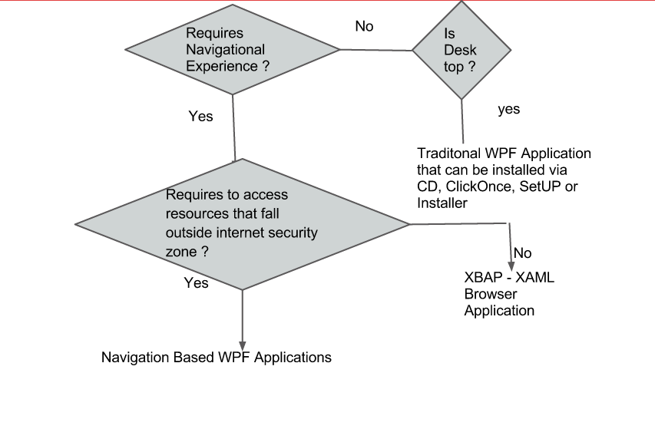
Types of WPF Application

Slide 48
First WPF Application

Slide 49
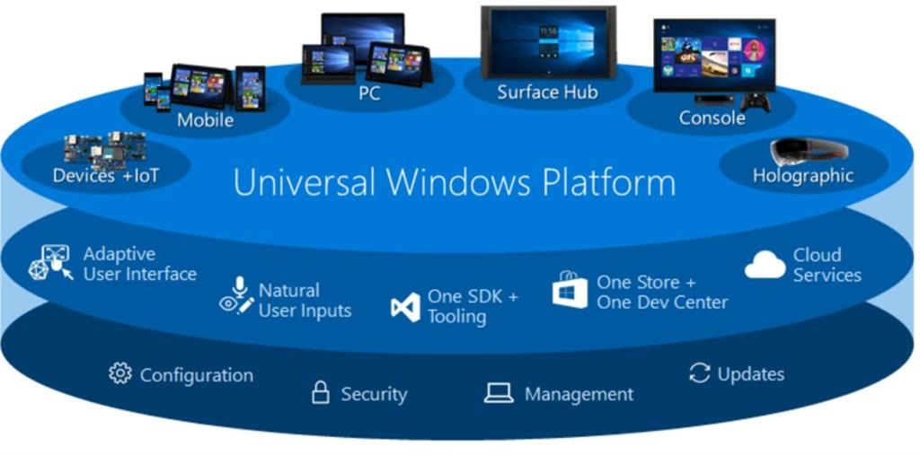
Universal window platfom

Slide 50
XAML – Extensible Application Markup Language
XAML (short for Extensible Application Markup Language and pronounced as “zammel”) is a markup language used to instantiate .NET objects.
Although XAML is a technology that can be applied to many different problem domains, its primary role in life is to construct WPF user interfaces.
XAML documents define the arrangement of panels, buttons, and controls that make up the windows in a WPF application.

Slide 51
XAML – Extensible Application Markup Language
We probably use XAML in Expression Blend or Visual Studio to develop rich media based applications for web and mobile devices.
Simply, creating any application in Blend called as writing XAML code either by typing the codes or visually designing and it automatically generates code.
Although XAML is developed for use on the Windows platform but the WPF/E (Windows Presentation Foundation/Everywhere) initiative will eventually bring XAML to other platforms and devices.

Slide 52
XAML – Extensible Application Markup Language
WPF (Windows Presentation Foundation) is a unified presentation subsystem for Windows, exposed through WinFX, the managed-code programming model for Windows Vista that extends the Microsoft .NET Framework.
WPF enables developers and designers to create visually stunning, differentiated user experiences. WPF is also based on XAML, to make building applications much easier for designers.

Slide 53
The Variants of XAML
WPF XAML encompasses the elements that describe WPF content, such as vector
graphics, controls, and documents. Currently, it’s the most significant application
of XAML, and it’s the subset.
XPS XAML is the part of WPF XAML that defines an XML representation for
formatted electronic documents.

Slide 54
The Variants of XAML
Silverlight XAML is a subset of WPF XAML that’s intended for Silverlight
applications. Silverlight is a cross-platform browser plug-in that allows you to create
rich web content with two-dimensional graphics, animation, and audio and video.
WF XAML encompasses the elements that describe Windows Workflow
Foundation (WF) content.

Slide 55
XAML Compilation
The creators of WPF knew that XAML needed to not just solve the problem of design collaboration—it also needed to be fast.
And though XML-based formats such as XAML are flexible and easily portable to other tools and platforms, they aren’t always the most efficient option.
XML was designed to be logical, readable, and straightforward, not compact.
WPF addresses this shortcoming with Binary Application Markup Language (BAML).
BAML is really nothing more than a binary representation of XAML. When you compile a WPF application in Visual Studio, all your XAML files are converted into BAML, and that BAML is then embedded as a resource into the final DLL or EXE assembly.
BAML is tokenized, which means lengthier bits of XAML are replaced with shorter tokens.

Slide 56
XAML Compilation
Not only is BAML significantly smaller, but it’s also optimized in a way that makes it
faster to parse at runtime.
Most developers won’t worry about the conversion of XAML to BAML because the compiler performs it behind the scenes.
However, it is possible to use XAML without compiling it first.
This might make sense in scenarios that require some of the user interface to be supplied just in time (for example, pulled out of a database as a block of XAML tags).

Slide 57
XAML Basics
Every element in a XAML document maps to an instance of a .NET class. The
name of the element matches the name of the class exactly. For example, the
element <Button> instructs WPF to create a Button object.
As with any XML document, you can nest one element inside another. As you’ll
see, XAML gives every class the flexibility to decide how it handles this situation.
If you find a Button element inside a Grid element, your user interface probably includes
a Grid that contains a Button inside.

Slide 58
XAML Basics
You can set the properties of each class through attributes. However, in some
situations an attribute isn’t powerful enough to handle the job.

Slide 59
WPF Top level Elements
Window
Page (which is similar to Window but used for navigable applications)
Application (which defines application resources and startup settings)

Slide 60
XAML Namespaces
The XAML parser needs to know the .NET namespace where this class is located. For example, the Window class could exist in several places—it might refer to the System.Windows.Window class, or it could refer to a Window class in a third-party component or one you’ve defined in your application.
xmlns="http://schemas.microsoft.com/winfx/2006/xaml/presentation"
xmlns:x="http://schemas.microsoft.com/winfx/2006/xaml"

Slide 61
XAML Namespaces
http://schemas.microsoft.com/winfx/2006/xaml/presentation is the core WPF
namespace.
It encompasses all the WPF classes, including the controls you use to
build user interfaces.
In this example, this namespace is declared without a namespace prefix, so it becomes the default namespace for the entire document.
In other words, every element is automatically placed in this namespace unless
you specify otherwise.

Slide 62
XAML Namespaces
http://schemas.microsoft.com/winfx/2006/xaml is the XAML namespace.
It includes various XAML utility features that allow you to influence how your
document is interpreted.
This namespace is mapped to the prefix x. That means you can apply it by placing the namespace prefix before the element name (as in <x:ElementName>).

Slide 63
The Code-Behind Class
XAML allows you to construct a user interface, but in order to make a functioning application you need a way to connect the event handlers that contain your application code.
XAML makes this easy using the Class attribute that’s shown here:
<Window x:Class="WindowsApplication1.Window1"
The x namespace prefix places the Class attribute in the XAML namespace, which means this is a more general part of the XAML language.

Slide 64
The Code-Behind Class
Visual Studio helps you out by automatically creating a partial class where you can place your event handling code. For example, if you create an application named WindowsApplication1, which contains a window named Window1 (as in the previous example), Visual Studionamespace WindowsApplication1
{
/// <summary>
/// Interaction logic for Window1.xaml
/// </summary>
public partial class Window1 : Window
{
public Window1()
{
InitializeComponent();
}
}
} will start you out with this basic skeleton of a class:

Slide 65
The InitializeComponent() Method
Currently, the Window1 class code doesn’t include any real functionality.
However, it does include one important detail—the default constructor, which calls InitializeComponent() when you create an instance of the class.
The InitializeComponent() method isn’t visible in your source code because it’s automatically generated when you compile your application.
Essentially, all InitializeComponent() does is call the LoadComponent() method of the System.Windows.Application class.
The LoadComponent() method extracts the BAML (the compiled XAML) from your assembly and uses it to build your user interface.
As it parses the BAML, it creates each control object, sets its properties, and attaches any event handlers.

Slide 66
Naming Elements
For example, you might want to read or change properties or attach and detach event handlers on the fly.
To make this possible, the control must include a XAML Name attribute.
<Grid x:Name="grid1">
</Grid>

Slide 67
Naming Elements
private System.Windows.Controls.Grid grid1;
MessageBox.Show(String.Format("The grid is {0}x{1} units in size.",
grid1.ActualWidth, grid1.ActualHeight));

Slide 68
Properties and Events in XAML
<TextBox Name="txtQuestion"
VerticalAlignment="Stretch" HorizontalAlignment="Stretch"
FontFamily="Verdana" FontSize="24" Foreground="Green" ... >
XAML, like all XML-based languages, is case-sensitive. That means you can’t substitute <button> for <Button>.
However, type converters usually aren’t case-sensitive, which means both Foreground="White" and Foreground="white" have the same result.

Slide 69
Complex properties
<Grid Name="grid1">
<Grid.Background>
<LinearGradientBrush>
<LinearGradientBrush.GradientStops>
<GradientStop Offset="0.00" Color="Red" />
<GradientStop Offset="0.50" Color="Indigo" />
<GradientStop Offset="1.00" Color="Violet" />
</LinearGradientBrush.GradientStops>
</LinearGradientBrush>
</Grid.Background>
...
</Grid>

Slide 70
Complex properties
LinearGradientBrush brush = new LinearGradientBrush();
GradientStop gradientStop1 = new GradientStop();
gradientStop1.Offset = 0;
gradientStop1.Color = Colors.Red;
brush.GradientStops.Add(gradientStop1);
GradientStop gradientStop2 = new GradientStop();
gradientStop2.Offset = 0.5;
gradientStop2.Color = Colors.Indigo;
brush.GradientStops.Add(gradientStop2);
GradientStop gradientStop3 = new GradientStop();
gradientStop3.Offset = 1;
gradientStop3.Color = Colors.Violet;
brush.GradientStops.Add(gradientStop3);
grid1.Background = brush;

Slide 71
Markup Extensions
<Button ... Foreground="{x:Static SystemColors.ActiveCaptionBrush}" >
All markup extensions are implemented by classes that derive from
System.Windows.Markup.MarkupExtension.
The base MarkupExtension class is extremely simple—it provides a single ProvideValue() method that gets the value you want.
In other words, when the XAML parser encounters the previous statement, it creates an instance of the StaticExtension class (passing in the string “SystemColors.ActiveCaptionBrush” as an argument to the constructor) and then calls
ProvideValue() to get the object returned by the SystemColors.ActiveCaption.Brush static property

Slide 72
Attached Properties
Along with ordinary properties, XAML also includes the concept of attached properties—properties that may apply to several controls but are defined in a different class.
In WPF, attached properties are frequently used to control layout.
Attached properties aren’t really properties at all. They’re actually translated into method calls. The XAML parser calls the static method that has this form: DefiningType.SetPropertyName().
For example, in the previous XAML snippet, the defining type is the Grid class, and the property is Row, so the parser calls Grid.SetRow().

Slide 73
Nesting Elements
XAML allows each element to decide how it deals with nested elements. This interaction is mediated through one of three mechanisms that are evaluated in this order:
If the parent implements IList, the parser calls IList.Add() and passes in the child.
If the parent implements IDictionary, the parser calls IDictionary.Add() and
passes in the child. When using a dictionary collection, you must also set the x:Key
attribute to give a key name to each item.
If the parent is decorated with the ContentProperty attribute, the parser uses the
child to set that property.

Slide 74
Nesting Elements
<LinearGradientBrush>
<LinearGradientBrush.GradientStops>
<GradientStopCollection>
<GradientStop Offset="0.00" Color="Red" />
<GradientStop Offset="0.50" Color="Indigo" />
<GradientStop Offset="1.00" Color="Violet" />
</GradientStopCollection>
</LinearGradientBrush.GradientStops>
</LinearGradientBrush>

Slide 75
Events
Attributes can also be used to attach event handlers.
The syntax for this is EventName="EventHandlerMethodName".
For example, the Button control provides a Click event. You can attach an event handler like this:
<Button ... Click="cmdAnswer_Click">

Slide 76
Events
private void cmdAnswer_Click(object sender, RoutedEventArgs e)
{
this.Cursor = Cursors.Wait;
// Dramatic delay...
System.Threading.Thread.Sleep(TimeSpan.FromSeconds(3));
AnswerGenerator generator = new AnswerGenerator();
txtAnswer.Text = generator.GetRandomAnswer(txtQuestion.Text);
this.Cursor = null;
}

Slide 77
Layout controls
WPF layout takes place in two stages: a measure stage and an arrange stage.
In the measure stage, the container loops through its child elements and asks them to provide their preferred size.
In the arrange stage, the container places the child elements in the appropriate position.

Slide 78
The Layout Containers

Slide 79
Core layout controls
StackPanel Places elements in a horizontal or vertical stack. This layout container is
typically used for small sections of a larger, more complex window.
WrapPanel Places elements in a series of wrapped lines. In horizontal orientation, the
WrapPanel lays items out in a row from left to right and then onto subsequent
lines.
In vertical orientation, the WrapPanel lays out items in a top-to-bottom
column and then uses additional columns to fit the remaining items.

Slide 80
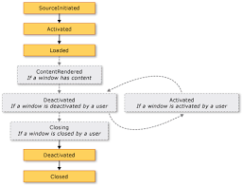
WPF Lifecycle events

Slide 81
WPF life cycle events
Startup: (Application)
This is the first lifetime event of Application to get fired. This is fired when Application.Run() is called on the main window. But before the main window is shown.
Application.Run() is abstracted from the user. If you want to check the compiler generated code, search under your project\obj folder for file named App.g.i.cs (g stands for generated).

Slide 82
WPF life cycle events
Initialized: (Window)
This is the first lifetime event of window to get fired. This is an ordinary .Net event and not a routed event.
When this event is fired at window level it means all its nested child controls are also already initialized.
So child controls will fire their Initialized event followed by parent control and finally by Window.

Slide 83
WPF life cycle events
Source Initialized : (Window)
Acquire a proper legacy handle to your window. But still your window is not visible.
It is worthy to note that this top level Window event has no equivalent for child controls. Because none of the WPF child controls have a HWND associated with it, strikingly different from Winforms model.

Slide 84
WPF life cycle events
Activated: (Window)
Equivalent to GotFocus of a control. Called every time when window comes foreground and also the first time window is rendered. Only after this event window loaded event isfired.

Slide 85
WPF life cycle events
Loaded: (Window)
Your entire window is ready. Last stop before rendering. All animation, styles and databinding will be ready here. Any visual tweaks needs to be done here.
This works in reverse order when compared with Initialized event. It is raised from root to child element from the fully constructed logical element tree. So window Load event will be raised first followed by any child element events.

Slide 86
WPF life cycle events
ContentRendered: (Window)
As the name implies it occurs after content was rendered. If there is no content this event will not be fired at all. Don't do any visual tweaks here. From here you may set a flag for your business logic that window is up, running and shown to the user for the first time.

Slide 87
WPF life cycle events
Shutdown order of events:
Closing: (Window)
Trigger can be user action or programmatic. user action can be direct like clicking on close button.
Logging off from windows did not raise this event.
In case of your program it can be a call to Window.Close() or Application.ShutDown().
In any case the event can be cancelled by overriding OnClosing() and setting CancelEventArgs.Cancel to true.

Slide 88
WPF life cycle events
Deactivated: (Window)
Happens if window loses focus (this is window equivalent to control.GotFocus()) or closed.

Slide 89
WPF life cycle events
Deactivated: (Application)
Happens if user switches to another application (by Alt-Tab, taskbar or task manager etc.) or as effect of application closure.
Closed: (Window)
Window is closed but window elements are accessible. Last place to access them if there is a reason. Note after this window unloaded will be fired.

Slide 90
WPF life cycle events
Exit: (Application)
Only the Run() method returns.
But if you have written your custom main() method instead of a generated one still you can add some business logic code here.
Any quick resource freeing can be done here.

Slide 91
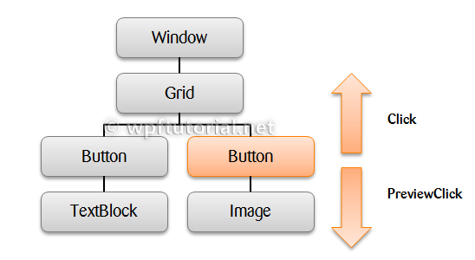
Routed events
Routed events are events which navigate up or down the visual tree acording to their RoutingStrategy. The routing strategy can be bubble, tunnel or direct.

Slide 92
Routed events
Tunneling The event is raised on the root element and navigates down to the visual tree until it reaches the source element or until the tunneling is stopped by marking the event as handeld. By naming convention it is called Preview... and appears before corresponding bubbling event.
The difference between a bubbling and a tunneling event (apart from the direction) is that a tunneling event name will always start with a ‘preview’.
In a WPF application, events are often implemented as a tunneling/bubbling pair. So, you'll have a previewMouseDown and then a MouseDown event.

Slide 93
Routed events
Bubbling The event is raised on the source element and navigates up to the visual tree until it reaches the root element or until the bubbling is stopped by marking the event as handled. The bubbling event is raised after the tunneling event.
WindowStackPanel 1
StackPanel 2
Textbox 1
Textbox 2
Button
if you click the Button, then the Bubbling event shall move in this direction,
Button > Stackpanel 1 > Window
If you click any of the Textboxes, then the event route will be,
Textbox 1 or 2 > Stackpanel 2 > Stackpanel 1> Window

Slide 94
Routed events
Direct The event is raised on the source element and must be handled on the source element itself. This behavior is the same as normal .NET events.
A good example of a direct event would be the MouseEnter event.

Slide 95
File upload
<Grid>
<Grid.ColumnDefinitions>
<ColumnDefinition Width="30*" />
<ColumnDefinition Width="349*" />
<ColumnDefinition Width="30*" />
</Grid.ColumnDefinitions>
<Image Margin="12,12,16,71" Name="imgPhoto"
Stretch="Fill" Grid.Column="1" />
<Button Height="23" HorizontalAlignment="Left"
Margin="12,0,0,34" Name="btnLoad" VerticalAlignment="Bottom"
Width="75" Grid.Column="1" Click="btnLoad_Click">_Load</Button>
</Grid>

Slide 96
File upload
private void btnLoad_Click(object sender, RoutedEventArgs e)
{
OpenFileDialog op = new OpenFileDialog();
op.Title = "Select a picture";
op.Filter = "All supported graphics|*.jpg;*.jpeg;*.png|" +
"JPEG (*.jpg;*.jpeg)|*.jpg;*.jpeg|" +
"Portable Network Graphic (*.png)|*.png";
if (op.ShowDialog() == true)
{
imgPhoto.Source = new BitmapImage(new Uri(op.FileName));
}
}

Slide 97
Confirm password
<Grid>
<TextBox Name="txtName" TextChanged="Content_TextChanged"/>
<PasswordBox Name="txtPass" PasswordChar="*" PasswordChanged="Content_TextChanged"/>
<PasswordBox Name="txtConfirmPass" PasswordChar="*" PasswordChanged="Content_TextChanged"/>
<Button Name="btSave" Content="Save" IsEnabled="False"/>
</Grid>

Slide 98
Confirm password
private void Content_TextChanged(object sender, TextChangedEventArgs e)
{
if (!txtName.Text.Equals(String.Empty) && txtPass.Password.Equals(txtConfirmPass.Password))
btSave.IsEnabled = true;
else
btSave.IsEnabled = false;
}

Slide 99
Core layout controls
DockPanel Aligns elements against an entire edge of the container.
Grid Arranges elements in rows and columns according to an invisible table. This is
one of the most flexible and commonly used layout containers.
UniformGrid Places elements in an invisible table but forces all cells to have the same size.
This layout container is used infrequently.
Canvas Allows elements to be positioned absolutely using fixed coordinates. This
layout container is the most similar to traditional Windows Forms, but it
doesn’t provide anchoring or docking features. As a result, it’s an unsuitable
choice for a resizable window unless you’re willing to do a fair bit of work.

Slide 100
Date converters
<TextBlock Text="{Binding Source={x:Static sys:DateTime.Now},
StringFormat='{}{0: Today is dddd, MMMM dd, yyyy, hh:mm:ss}'}"/>

Slide 101
Resource Reference
<Application.Resources>
<ResourceDictionary>
<vm:ViewModelLocator x:Key="Locator" d:IsDataSource="True" />
<ResourceDictionary.MergedDictionaries>
<ResourceDictionary Source="View\SomeFileDictionary.xaml"/>
</ResourceDictionary.MergedDictionaries>
</ResourceDictionary>
</Application.Resources>

Slide 102
Templates
Each control has its own default template associated with it. Using styles, you can only modify the default associated template. WPF enables you to change the look and feel of the controls and this can be achieved by using the templates.
There are four types of templates, which are shown below.
Control Template
Data Template
ItemsPanel Template
HierarchalData Template

Slide 103
Commands
Commanding is an input mechanism in Windows Presentation Foundation (WPF) which provides input handling at a more semantic level than device input.
Examples of commands are the Copy, Cut, and Paste operations found on many applications.
An application might allow a user to cut selected objects or text by either clicking a button, choosing an item in a menu, or using a key combination, such as CTRL+X. By using commands, you can bind each type of user action to the same logic.

Slide 104
Commands
Another purpose of command is to indicate whether an action is available.
To continue the example of cutting an object or text, the action only makes sense when something is selected.
If a user tries to cut an object or text without having anything selected, nothing would happen. To indicate this to the user, many applications disable buttons and menu items so that the user knows whether it is possible to perform an action.
A command can indicate whether an action is possible by implementing the CanExecute method.
A button can subscribe to the CanExecuteChanged event and be disabled if CanExecute returns false or be enabled if CanExecute returns true.

Slide 105
Commands
The semantics of a command can be consistent across applications and classes, but the logic of the action is specific to the particular object acted upon.
The key combination CTRL+X invokes the Cut command in text classes, image classes, and Web browsers, but the actual logic for performing the Cut operation is defined by the application that performs the cut.

Slide 106
Commands
A RoutedCommand enables clients to implement the logic.
A text object may cut the selected text into the clipboard, while an image object may cut the selected image.
When an application handles the Executedevent, it has access to the target of the command and can take appropriate action depending on the target's type.

Slide 107
Four Main Concepts in WPF Commanding
The routed command model in WPF can be broken up into four main concepts: the command, the command source, the command target, and the command binding:
The command is the action to be executed.
The command source is the object which invokes the command.
The command target is the object that the command is being executed on.
The command binding is the object which maps the command logic to the command.
the Paste command is the command, the MenuItem is the command source, the TextBox is the command target, and the command binding is supplied by the TextBox control.

Slide 108
Commands
Commands in WPF are created by implementing the ICommand interface.
ICommand exposes two methods, Execute, and CanExecute, and an event, CanExecuteChanged.
Execute performs the actions that are associated with the command.
CanExecute determines whether the command can execute on the current command target.
CanExecuteChanged is raised if the command manager that centralizes the commanding operations detects a change in the command source that might invalidate a command that has been raised but not yet executed by the command binding.

Slide 109
Custom commands

Slide 110
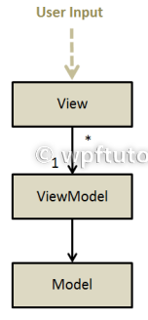
MVVM architecture
The model-view-viewmodel is a typically WPF pattern.
It consists of a view, that gets all the user input and forwards it to the viewmodel, typically by using commands.
The view actively pulls the data from the viewmodel by using databinding.
The model does not know about the view model.

Slide 111
View
Responsibility
To present the data available at the DataContext to the end user to allow him to interact with it.
Design Tips
Avoid putting logic on the View even when XAML allows to do it. Prefer moving that logic to the ViewModel over adding it to the View because:
XAML logic cannot be debugged.
XAML logic cannot be tested.

Slide 112
model
Responsibility To model a business object containing the required data.
Design Tips As the model is only a representation of the data of a business entity (object) it should contain only properties containing object’s data and constructors.
Implementing INotifyPropertyChanged is right as we consider this part of the object’s responsibility.

Slide 113
View model
ResponsibilityTo contain the logic that acts as a bridge between the View and the Model.
Design TipsAvoid putting too much logic inside the ViewModel and consider creating more classes (services, engines, etc.) if the ViewModel logic is too big to fit in one class.
Include always a reference to the model on the ViewModel.

Slide 114
The MVVM pattern provides the following benefits:
It helps to have a better Separation of concerns.
It allows to replace the View with a new one without changing the ViewModel.
It allows to easily unit test View's logic as now it is in a normal class (the ViewModel).
It allows graphics designers to work in the View without touching any logic.

Slide 115
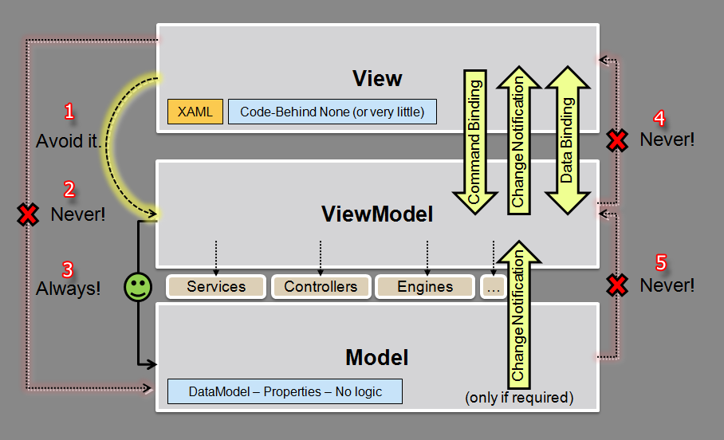

Slide 116
Some MVVM Frameworks
PRISM (Microsoft)
MVVM Light (Laurent Bugnion)
WPF Application Framework
Chinch
Caliburn Micro
Core MVVM
Onyx
nRoute
MVVM Foundation
How to build your own MVVM Framework

Slide 117
Animations
Windows Presentation Foundation (WPF) provides a powerful set of graphics and layout features that enable you to create attractive user interfaces and appealing documents.
Animation can make an attractive user interface even more spectacular and usable.
By just animating a background color or applying an animated Transform, you can create dramatic screen transitions or provide helpful visual cues.

Slide 118
Animations
Animation is an illusion that is created by quickly cycling through a series of images, each slightly different from the last.
The brain perceives the group of images as a single changing scene.
In film, this illusion is created by using cameras that record many photographs, or frames, each second.
When the frames are played back by a projector, the audience sees a moving picture.

Slide 119
Animations
Animation on a computer is similar. For example, a program that makes a drawing of a rectangle fade out of view might work as follows.
The program creates a timer.
The program checks the timer at set intervals to see how much time has elapsed.
Each time the program checks the timer, it computes the current opacity value for the rectangle based on how much time has elapsed.
The program then updates the rectangle with the new value and redraws it.

Slide 120
WPF Property Animation System
For a property to have animation capabilities, it must meet the following three requirements:
It must be a dependency property.
It must belong to a class that inherits from DependencyObject and implements the IAnimatable interface.
There must be a compatible animation type available.
A DoubleAnimation creates a transition between two double values. To specify its starting value, you set its From property. To specify its ending value, you set its To property.

Slide 121
Animation Types
Because animations generate property values, different animation types exist for different property types.
To animate a property that takes a Double, such as the Width property of an element, use an animation that produces Double values.
To animate a property that takes a Point, use an animation that produces Point values, and so on.
Because of the number of different property types, there are several animation classes in the System.Windows.Media.Animation namespace.

Slide 122
Animation Types
<Type>Animation
Known as a "From/To/By" or "basic" animation, these animate between a starting and destination value, or by adding an offset value to its starting value.
To specify a starting value, set the From property of the animation.
To specify an ending value, set the To property of the animation.
To specify an offset value, set the By property of the animation.

Slide 123
Animation Types
<Type>AnimationUsingKeyFrames
Key frame animations are more powerful than From/To/By animations because you can specify any number of target values and even control their interpolation method. Some types can only be animated with key frame animations.

Slide 124
Animation Types
<Type>AnimationUsingPath
Path animations enable you to use a geometric path in order to produce animated values.

Slide 125
Animation Types
<Type>AnimationBase
Abstract class that, when you implement it, animates a <Type> value.
This class serves as the base class for <Type>Animation and <Type>AnimationUsingKeyFrames classes.
You have to deal directly with these classes only if you want to create your own custom animations. Otherwise, use a <Type>Animation or KeyFrame<Type>Animation.

Slide 126
Animation Types
Property type | Corresponding basic (From/To/By) animation | Corresponding key frame animation | Corresponding Path Animation | Usage example
Color | ColorAnimation | ColorAnimationUsingKeyFrames | None | Animate the Color of a SolidColorBrushor a GradientStop.
Double | DoubleAnimation | DoubleAnimationUsingKeyFrames | DoubleAnimationUsingPath | Animate the Width of a DockPanel or the Height of a Button.
Point | PointAnimation | PointAnimationUsingKeyFrames | PointAnimationUsingPath | Animate the Center position of an EllipseGeometry.
String | None | StringAnimationUsingKeyFrames | None | Animate the Text of a TextBlock or the Content of a Button.

Slide 127
Animations Are Timelines
All the animation types inherit from the Timeline class; therefore, all animations are specialized types of timelines. A Timeline defines a segment of time. You can specify the timing behaviors of a timeline: its Duration, how many times it is repeated, and even how fast time progresses for it.
Because an animation is a Timeline, it also represents a segment of time. An animation also calculates output values as it progresses though its specified segment of time (or Duration). As the animation progresses, or "plays," it updates the property that it is associated with.
Three frequently used timing properties are Duration, AutoReverse, and RepeatBehavior.

Slide 128
The Duration Property
The length of that segment is determined by the Duration of the timeline, which is usually specified by using a TimeSpan value. When a timeline reaches the end of its duration, it has completed an iteration.
An animation uses its Duration property to determine its current value. If you do not specify a Duration value for an animation, it uses 1 second, which is the default.

Slide 129
AutoReverse
The AutoReverse property specifies whether a timeline plays backward after it reaches the end of its Duration.
If you set this animation property to true, an animation reverses after it reaches the end of its Duration, playing from its ending value back to its starting value. By default, this property is false.

Slide 130
RepeatBehavior
The RepeatBehavior property specifies how many times a timeline plays. By default, timelines have an iteration count of 1.0, which means they play one time and do not repeat at all.

Slide 131
Bitmap effects
WPF (Windows Presentation Foundation) has five special visual effects built in to the System.
Windows.Media.Effects namespace that can be applied to any UIElement, DrawingGroup and ViewPort3DVisualCovered.
Bitmap effects enable designers and developers to apply visual effects to rendered Microsoft Windows Presentation Foundation (WPF) content.
For example, abitmap effects allow you to easily apply a DropShadowBitmapEffect effect or a blur effect to n image or a button. The unmanaged APIs provide an extensible framework for independent hardware vendors (IHVs) to develop custom effects to use in WPF applications.

Slide 132
Writeable Bitmap
WriteableBitmap wb = new WriteableBitmap((int)this.ActualWidth,
(int)this.ActualHeight, 96, 96, PixelFormats.Bgra32, null);

Slide 133
Writeable Bitmap
Bgra32. This format (the one used in the current example) uses 32-bit sRGB color.
That means that each pixel is represented by 32 bits, or 4 bytes.
The first byte represents the contribution of the blue channel (as a number from 0 to 255).
The second byte is for the green channel, the third is for the red channel, and the
fourth is for the alpha value (where 0 is completely transparent and 255 is
completely opaque). As you can see, the order of the colors (blue, green, red,
alpha) matches the letters in the name Bgra32.

Slide 134
Writeable Bitmap
Bgr32. This format uses 4 bytes per pixel, just like Bgra32. The difference is that
the alpha channel is ignored. You can use this format when transparency is not
required.

Slide 135
Writeable Bitmap
Bgr32. This format uses 4 bytes per pixel, just like Bgra32. The difference is that
the alpha channel is ignored. You can use this format when transparency is not
required.

Slide 136
Writeable Bitmap
Pbgra32. This format uses 4 bytes per pixel, just like Bgra32. The difference is the
way it handles semitransparent pixels. In order to optimize the performance of
opacity calculations, each color byte is premultiplied (hence the P in Pbgra32

Slide 137
Animation
Transform
Brush types (Linear and Radial)

Slide 138
Navigation based applications
Windows Presentation Foundation (WPF) supports browser-style navigation that can be used in two types of applications: standalone applications and XAML browser applications (XBAPs). To package content for navigation, WPF provides the Page class.
WPF provides the Page class. You can navigate from one Page to another declaratively, by using a Hyperlink, or programmatically, by using the NavigationService.

Slide 139
XBAP Application
XAML browser applications (XBAPs) combines features of both Web applications and rich-client applications.

Slide 140
Documents in WPF
Windows Presentation Foundation (WPF) offers a wide range of document features that enable the creation of high-fidelity content that is designed to be more easily accessed and read than in previous generations of Windows.

Slide 141
Types of Documents
WPF divides documents into two broad categories based on their intended use; these document categories are termed "fixed documents" and "flow documents.“
Typical uses for fixed documents include desktop publishing, word processing, and form layout, where adherence to the original page design is critical.
For example, a fixed document page viewed on 96 dpi display will appear exactly the same when it is output to a 600 dpi laser printer as when it is output to a 4800 dpi phototypesetter. The page layout remains the same in all cases, while the document quality maximizes to the capabilities of each device.

Slide 142
Types of Documents
Flow documents are designed to optimize viewing and readability and are best utilized when ease of reading is the primary document consumption scenario.
Flow documents are designed to optimize viewing and readability and are best utilized when ease of reading is the primary document consumption scenario

